Slide 1
Collision Lab

Slide 2
Collision Lab
Take a look at examples of collision and why it can be dangerous
Materials needed
Kali Linux Machine
Software Tools used
md5sum (Linux command to use MD5 to hash a file)
sha256sum (Linux command to use SHA256 to hash a file)
sha512sum (Linux command to use SHA512 to hash a file)

Slide 3
Objectives Covered
Security+ Objectives (SY0-501)
Objective 1.2 Compare and contrast types of attacks
Cryptographic attacks
Collision
Objective 6.1 - Compare and contrast basic concepts of cryptography
Collision

Slide 4
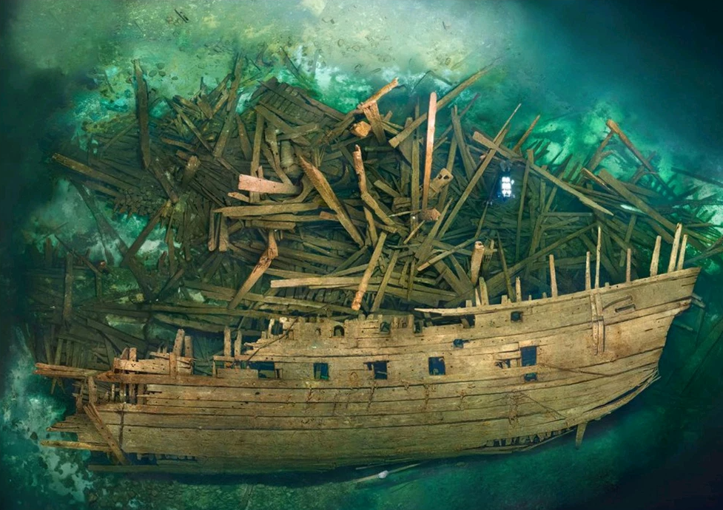
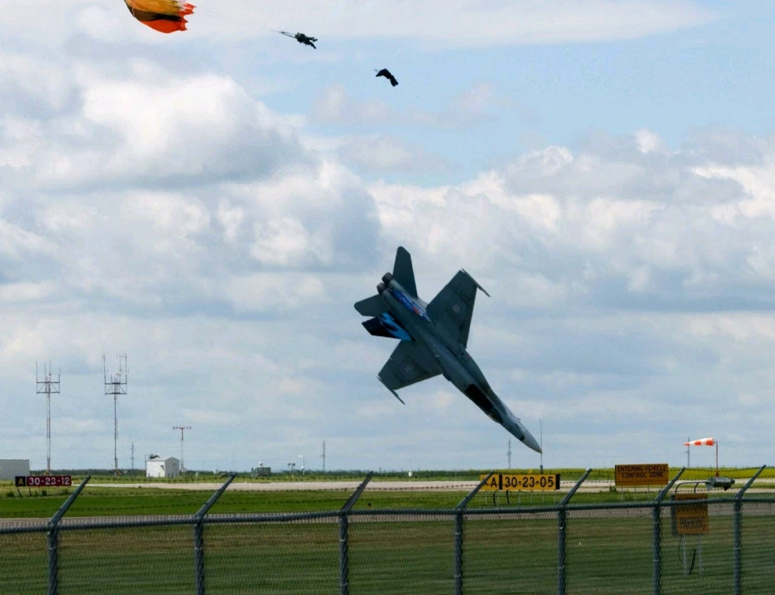
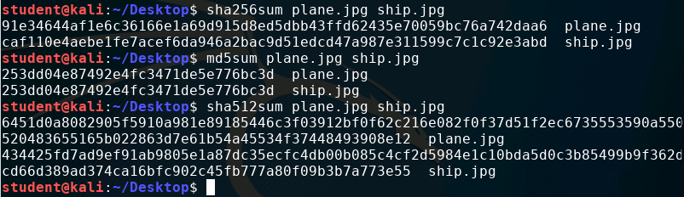
What is Collision?
Collision is when the hashes of two different hashed files match
Two different files
Same hash
ship.jpg
plane.jpg
Collision

Slide 5
The Collision Lab
Setup Environment
Get Collision Lab Files
Collision Example
Why Collision should not happen
Why is Collision Bad?
How to Avoid Collision?

Slide 6
Setup Environment
Log into your range
Open the Kali Linux Environment
You should be on your Kali Linux Desktop

Slide 7
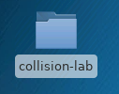
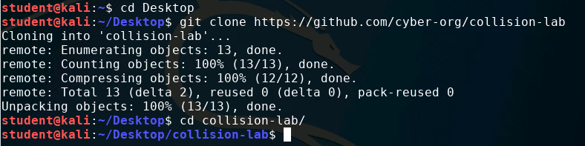
Get Collision Lab Files
Open the terminal and navigate to the Desktop
cd Desktop
Download Collision Lab files
git clone https://github.com/cyber-org/collision-lab
You should see the Collision Lab folder
Navigate into this directory
cd collision-lab

Slide 8
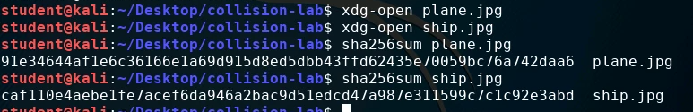
Collision Example
View the plane.jpg and ship.jpg
xdg-open plane.jpg
xdg-open ship.jpg
These Terminal commands will open the images in an image viewer
Notice how they are two different images
Exit out of the image viewer (back to terminal)
Run a SHA-256 checksum on the images
sha256sum plane.jpg
sha256sum ship.jpg
Notice the different SHA-256 checksum for the images

Slide 9

Collision Example
What happens if we run a MD5 checksum on the images?
md5sum plane.jpg
md5sum ship.jpg
Notice the two checksums are the same! We have a collision.
Collision

Slide 10
Why Collision should not happen
Open the copy of Tale of Two Cities with a text editor*
leafpad TaleofTwoCities.txt
Notice, this is a copy of the novel A Tale of Two Cities
Exit out of Leafpad
Create a copy of TaleofTwoCities.txt
cp TaleofTwoCities.txt TaleofTwoCitiesCopy.txt
*If Leafpad is not installed, run the following command:
sudo apt-get install leafpad

Slide 11

Why Collision should not happen
Check to make sure the MD5 checksums are the same
md5sum TaleofTwoCities.txt
md5sum TaleofTwoCitiesCopy.txt
You should notice they have the same checksum
This is because they are the same file

Slide 12
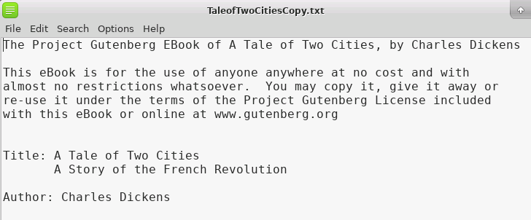
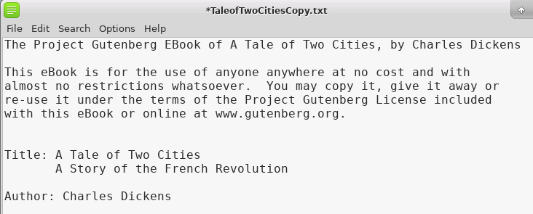
Why Collision should not happen
Make a tiny change in the copy
Open the copy in a text editor
leafpad TaleofTwoCitiesCopy.txt
Make a minor change and save
Exit Leafpad
Added a period after www.Gutenberg.org

Slide 13

Why Collision should not happen
Check the MD5 hashes again
md5sum TaleofTwoCities.txt
md5sum TaleofTwoCitiesCopy.txt
Are the hashes the same? How different are they?
Notice one minor change should completely change the hash

Slide 14
Why is Collision Bad?
If you’ve run through the File Hashing Lab, you should know that checksums is a way to verify that a file has not been changed or tampered with
What if a malicious program can have the same checksum of a program that the user wanted to download?
Take a look at an example of a good program and a malicious program that was made by Peter Selinger*
*Read more about these programs at the following website:
https://www.mscs.dal.ca/~selinger/md5collision/

Slide 15

Why is Collision Bad?
Check the MD5 hashes of the two programs
md5sum hello
md5sum erase
You should notice these two programs have the same MD5 checksums
This is another example of a collision!

Slide 16
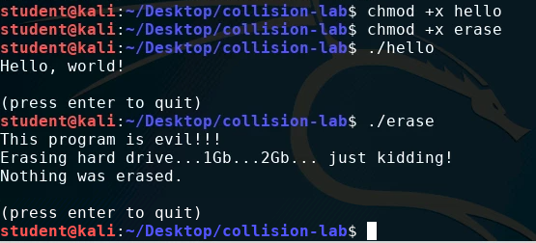
Why is Collision Bad?
Try to run the two programs
Make the programs executable
chmod +x hello
chmod +x erase
Run the programs
./hello
./erase
What if a user was trying to download the hello program, verified it with the MD5 checksum, but it was actually the erase program?

Slide 17
How to Avoid Collision?
Avoid using MD5 hashes! (and other weak encryptions)
MD5 checksum have been proven to have collisions
Use stronger encryption methods
Check using SHA-256
Check using SHA-512
How else can you avoid collisions?

